Slide 1
CGB1221 – DATABASE MANAGEMENT SYSTEM
Department of Artificial Intelligence and Data Science
Academic Year: 2024 – 2025 (Even Semester)
Register Number : 2303811724321119
Name : Vaithyanadhan S G
Year : II Year
Semester : IV
Section : B
Date : 04-06-2025

Slide 2
Project Title
Cab Website for a Company

Slide 3
Problem Identification
Delays in Cab Allocation : Employees wait too long for cabs due to manual assignment.
Unclear Fare Calculation : No proper fare estimation, leading to overcharging and confusion.
Driver Management Issues : No proper system to assign and manage driver schedules.
Lack of Ride History : Companies cannot easily track past rides and expenses.

Slide 4
Objective
User Login & Management: Employees and admins can register, log in, and manage profiles.
Cab Booking: Users can book a cab, and the system assigns an available driver.
Fare Calculation: The system calculates the fare based on distance and time.
Driver Management: The system assigns and updates driver availability.
Ride History: Users and admins can view past bookings and payments.

Slide 5
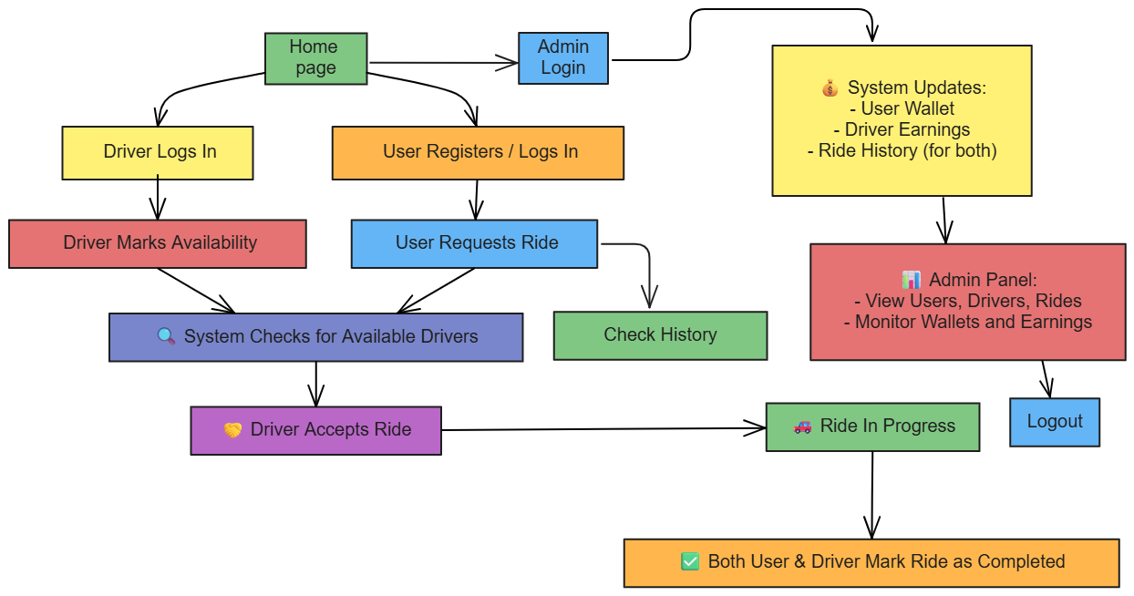
Proposed Architecture

Slide 6
List of Modules
User Modules:
User Registration & Login, User Dashboard, Wallet System
Driver Module:
Driver Login , Driver Dashboard, Ride Assignment, Driver Earning Tracker
Admin Module:
Login & Dashboard, Ride & Wallet Monitoring
History & Calculation Module:FFFFFFFFFFFFFFF
Ride History, Ride Booking and Cancellation with Refund, Calculates the Fair of User
F

Slide 7
Module Description
User Module
User Registration & Login: Enables new users to register and securely log in with authentication.
User Dashboard: Central hub to book rides, view history, and track ride status.
Ride Booking: Allows users to select pickup and destination, and book a ride.
Ride Cancellation & Refund: Lets users cancel rides and receive full or 50% refund based on driver assignment.
Wallet System: Manages user fare deduction and refunds through wallet balance updates.

Slide 8
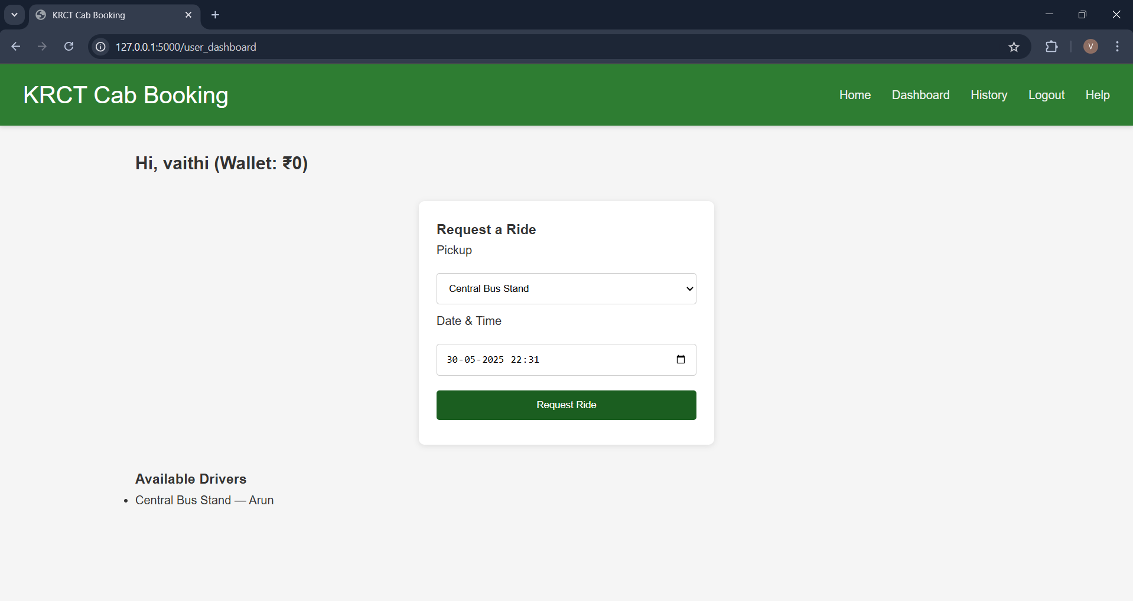
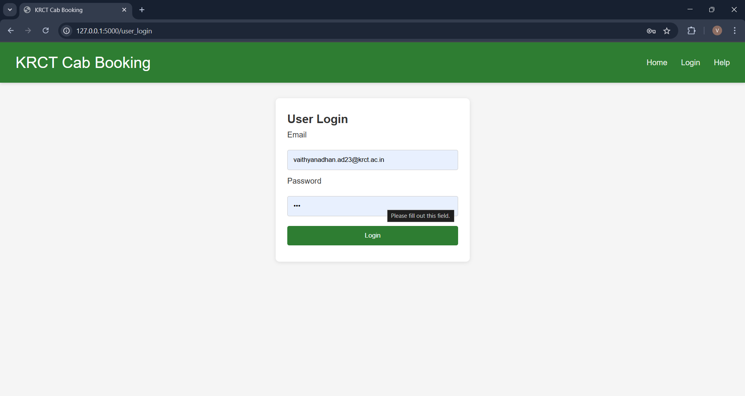
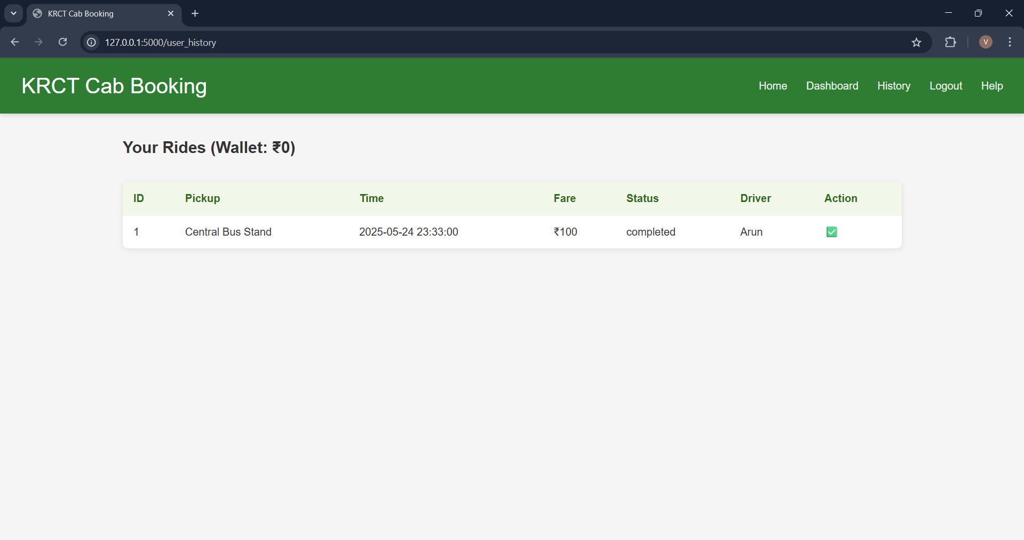
Results
User Login:

Slide 9
Module Description
Admin Module
Admin Login & Dashboard: Pprovides centralized access to monitor users, drivers, and rides.
Ride & Wallet Monitoring: Allows admin to track ride statuses, payments, and refunds.

Slide 10
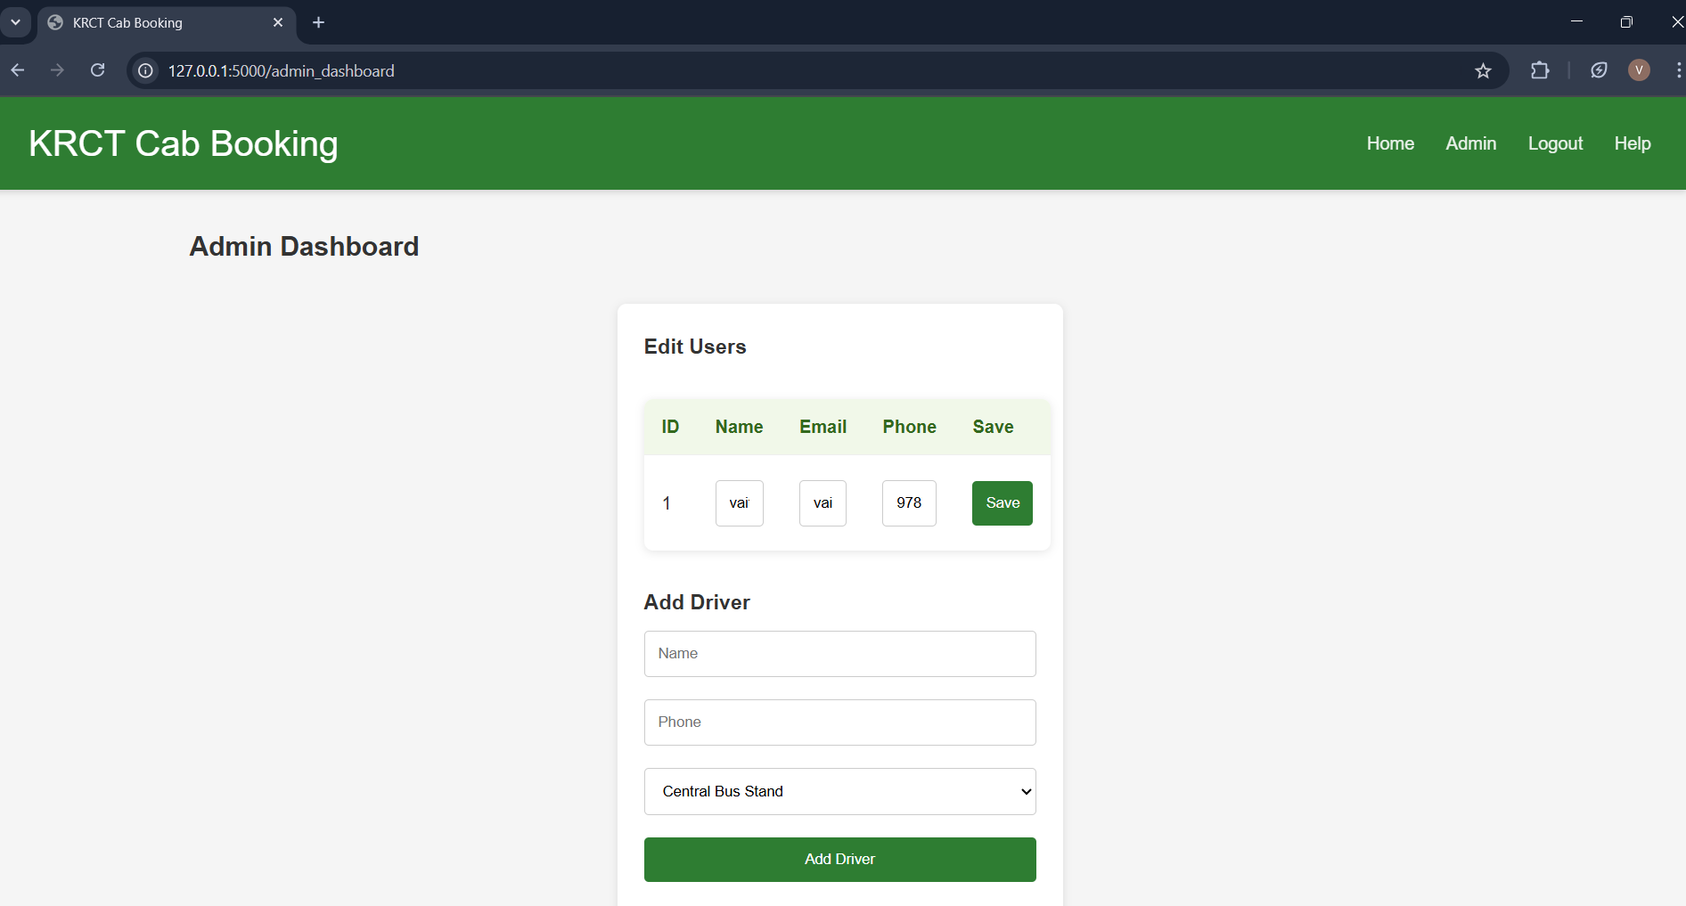
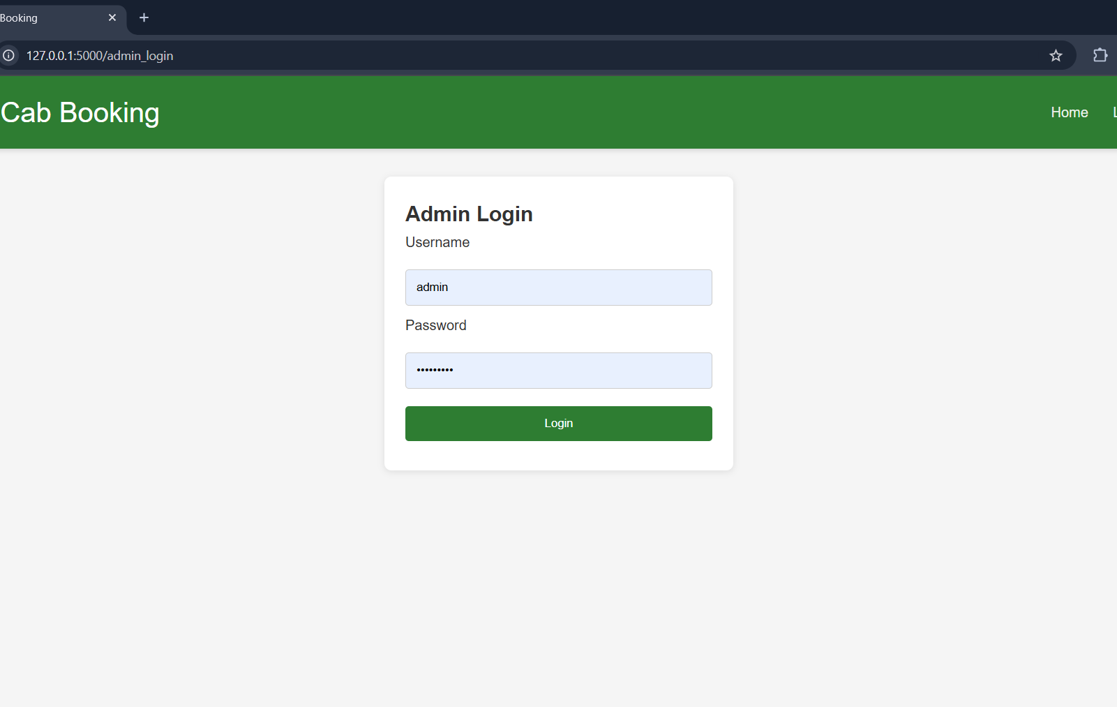
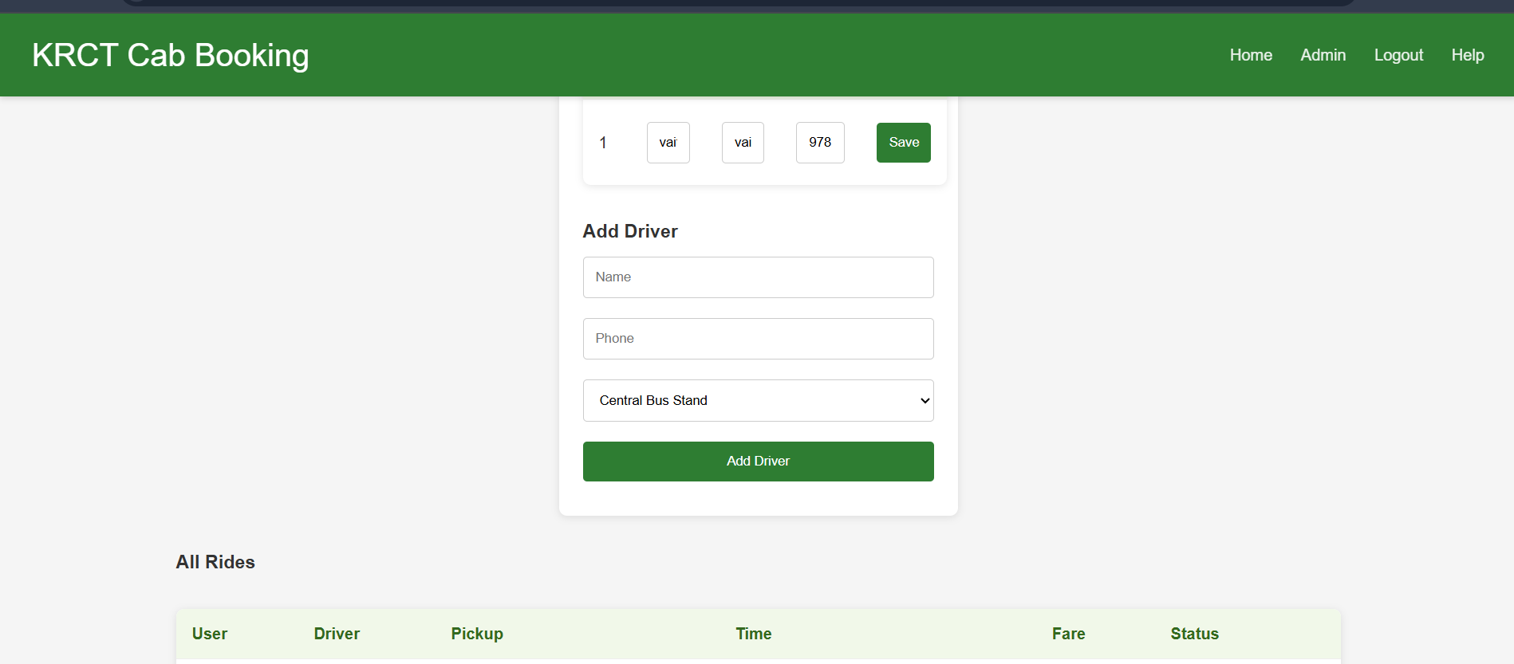
Results
Admin Login:

Slide 11
Module Description
Driver Modules:
Driver Login: Authenticates driver access using predefined database credentials.
Driver Dashboard: Shows available ride requests and allows drivers to manage rides.
Ride Assignment: Enables drivers to accept rides manually and prevents double booking.
Driver Earnings Tracker: Tracks and displays driver income from completed or cancelled rides.

Slide 12
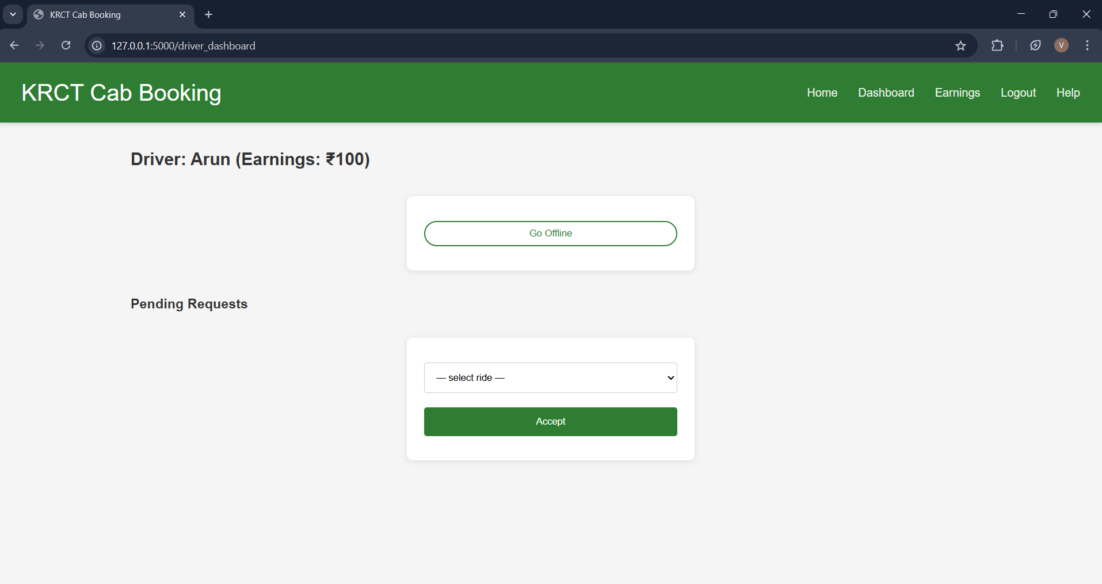
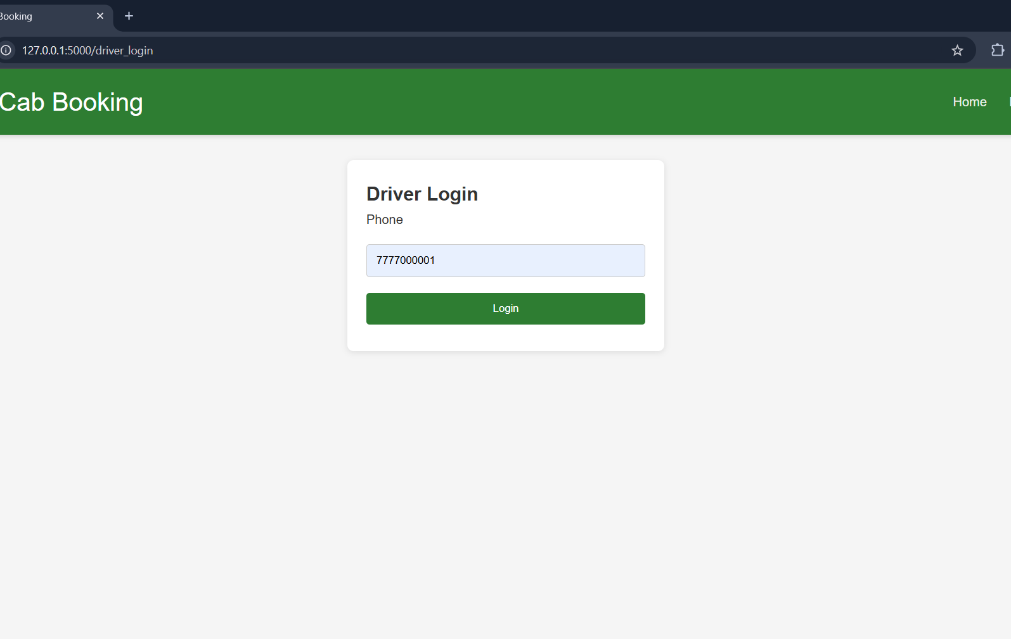
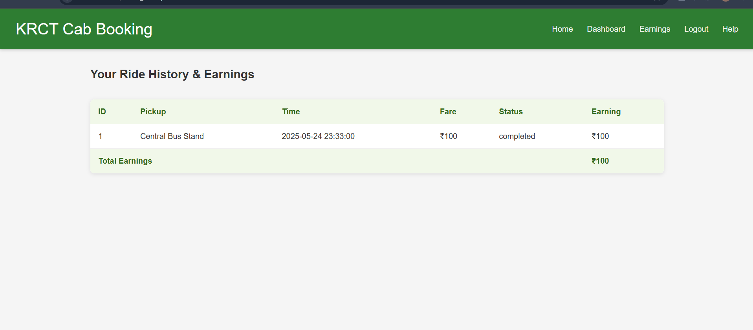
Results
Driver Login:

Slide 13
Module Description
History & Calculation Modules:
To track ride: completed/canceled rides, user refund eligibility, and driver earnings.
User Ride History: Shows list of past rides with fare and refund status.
Driver Ride History: Lists all accepted rides, status, and earnings.
Refund Logic: Applies full or 50% refund based on driver assignment.
Earnings Table: Displays per-driver summary with total amount earned.

Slide 14
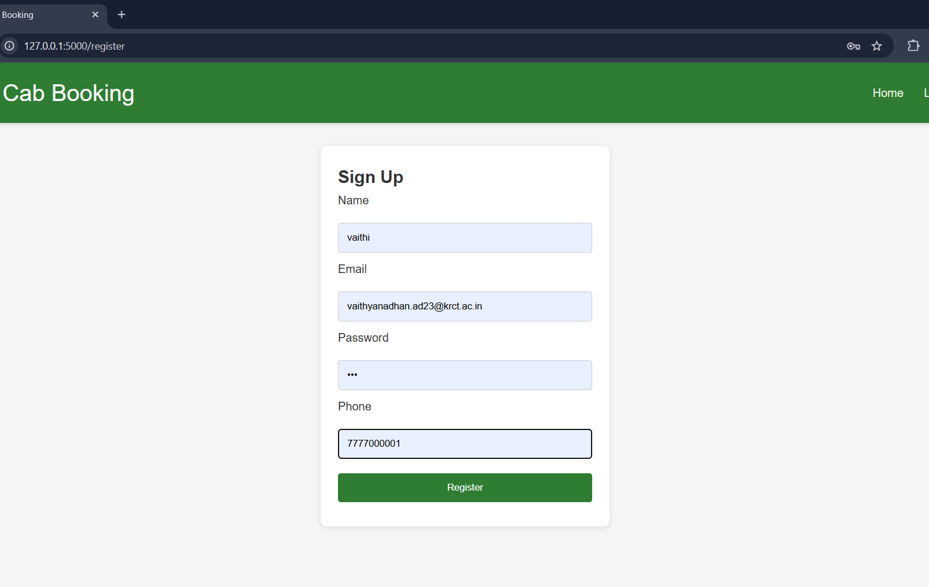
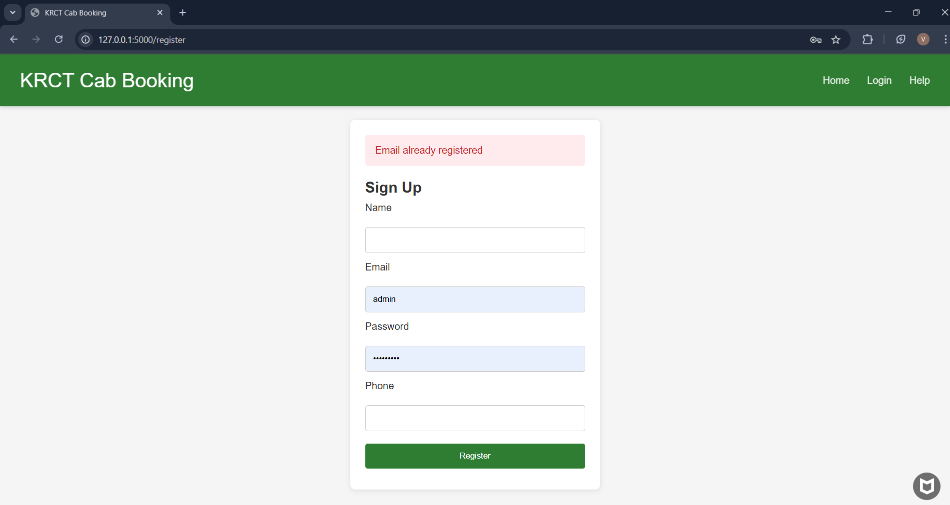
Results
Register New User:

Slide 15
Conclusion & Future Scope
Conclusion:
The Cab Booking System effectively demonstrates the application of Database Management System (DBMS) principles by managing user, driver, and ride data efficiently through structured MySQL integration.
Future Scope:
Introduce advanced SQL procedures and triggers to automate refund and wallet updates.
Integrate real-time GPS tracking and location-based cab suggestions using spatial databases to enhance ride assignment accuracy.

Slide 16
Thank You
ANY QUERIES???

